Slide 1
Multi-Mega Particle System
-Rethinking Particle Systems in Games-
By Wolfgang Engel
The Forge Interactive
September 7th, 2023 Breadstick Con
September 8th, 2023 Digipen

Slide 2

The Forge Interactive (https://theforge.dev/)
Founded in 2009
Worked since then on the forefront of graphics development and on many AAA titles of the industry with companies like
  Dolby
  EA
  Activision
  Microsoft
  Google
  Amazon
  Bungie
  Meta / Facebook / Oculus
  Qualcomm
  Intel
  AMD
  Hypixel
  id Software
  Crystal Dynamics
  Epic
  Supergiant Games
  And many others …

Slide 3
The Forge Rendering Framework
Cross-Platform Rendering and Ray Tracing Framework https://github.com/ConfettiFX/The-Forge
“Easy” “Drag&Drop” replacement for the rendering layer in game engines ☺
  Adding new target platforms to a game
Build new game engines from scratch

Slide 4
The Forge Rendering Framework
PC
  Windows 7/10/11
    with DirectX 12 / Vulkan 1.3
    DirectX 11 for Windows 7 support
Android 10 Vulkan min spec of 1.1.87 and a max spec 1.3
Steamdeck native SteamOS with Vulkan 1.3
Quest with Vulkan 1.3
macOS / iOS / iPad OS with min spec Metal 2.0 and max spec Metal 3
XBOX all of them*
PS4 / PS4 Pro*
PS5*
Switch with Vulkan 1.3 *
*only available for accredited developers on request

Slide 5
The Forge Rendering Framework
Currently three research projects
  Cross-platform Software Rasterizer
  Visibility Buffer 2.0 – one big compute shader + simplified software rasterizer
    Visibility data is stored in the Visibility Buffer with one big compute shader … so no ExecuteIndirect or any draw calls anymore
    There is the main one draw call shading pass after VB is filled. It does some of the rasterization work, therefore the software rasterizer in the previous pass can be simpler than the one described above
  Meta-Particle system – one big compute shader + simplified software rasterizer
See a pattern? One big compute shader + software rasterizer … called GPU Driven rendering
-> Re-thinking of how we render and organize data …
-> GPU Work Graphs will offer more opportunities if they work out

Slide 6
History of the Multi-Mega Particle System
This presentation should have happened in 2010
We developed a particle system that offered to deal with 1000x the amount of particles compared to the contemporary systems
It was inspired by all the shortcomings of the R* particle systems
-> two of the three founders of the company left R*
The initial idea was simple: run particles on the GPU instead of the CPU
Today we would call this GPU driven rendering
The resulting system was called Confetti: It felt like we were too far ahead of the curve

Slide 7
History of the Multi-Mega Particle System
Among many other things, we spent the last 14 years improving and re-implementing existing particle systems
  tagging the “GPU driven” approach on top of what was there by adding a “tab” for a GPU system and keeping the old CPU system as it is
When it comes to particle system architecture, not much has changed since 2010, the majority of particle systems deals with “small” numbers of particles and then there is occasionally an outlier particle effect that runs on the GPU like rain, or liquid

Slide 8
Motivation
The reason why there was no innovation in the area of real-time game particle systems was a kind of dead-lock scenario
Existing particle systems can only deal with dozens or a few hundred particles per effect
  Most of them are inherently CPU driven or developed in a way that they require CPU interactions before the GPU takes over; holding back the GPU substantially
  The tool set is tailored to “small scale” particles, astonishingly rigid, dealing with larger number of particles would require different ways to control them
Therefore artists were trained in always carefully tuning the number of particles to these limits
-> like a self-fulfilling prophecy the effects were kept at those low number of particles this way although the GPU processing power increased

Slide 9
Motivation
Now think about a particle system whose assumption is that your effects use instead of a dozen or a few hundred particles a
–let’s say- 100000 at least
A particle system that can cast lights and shadows from each particle
Think off Lava or Water or any liquid as being part of the particle system
Think of any “herd” of animals in your game as particles that are flocking and doing random animal things
-> flock of seagulls, pack of wolfs, pack of lions, fireflies, bee swarms, ants etc..
With less ”manual” control by using AI for example flocking algorithms to make the large number of particles move ”randomly” naturally
You can call it rendering system for large quantities of similar data ☺

Slide 10
Motivation
Think off Spiderman’s Sandman dissolving into sand in front of your eyes and re-building himself afterwards
We wrote a demo like this in 2010 on a mobile phone for Qualcomm … they used it for many years as a demo on exhibitions

Slide 11
Results
Samsung S22 Phone as the target platform
  3 million particles
  10K particles with point lights attached
  1 point light with cube map shadows (work in progress …)
Phone heats up in 15 seconds and reduces frame rate ☺

Slide 12
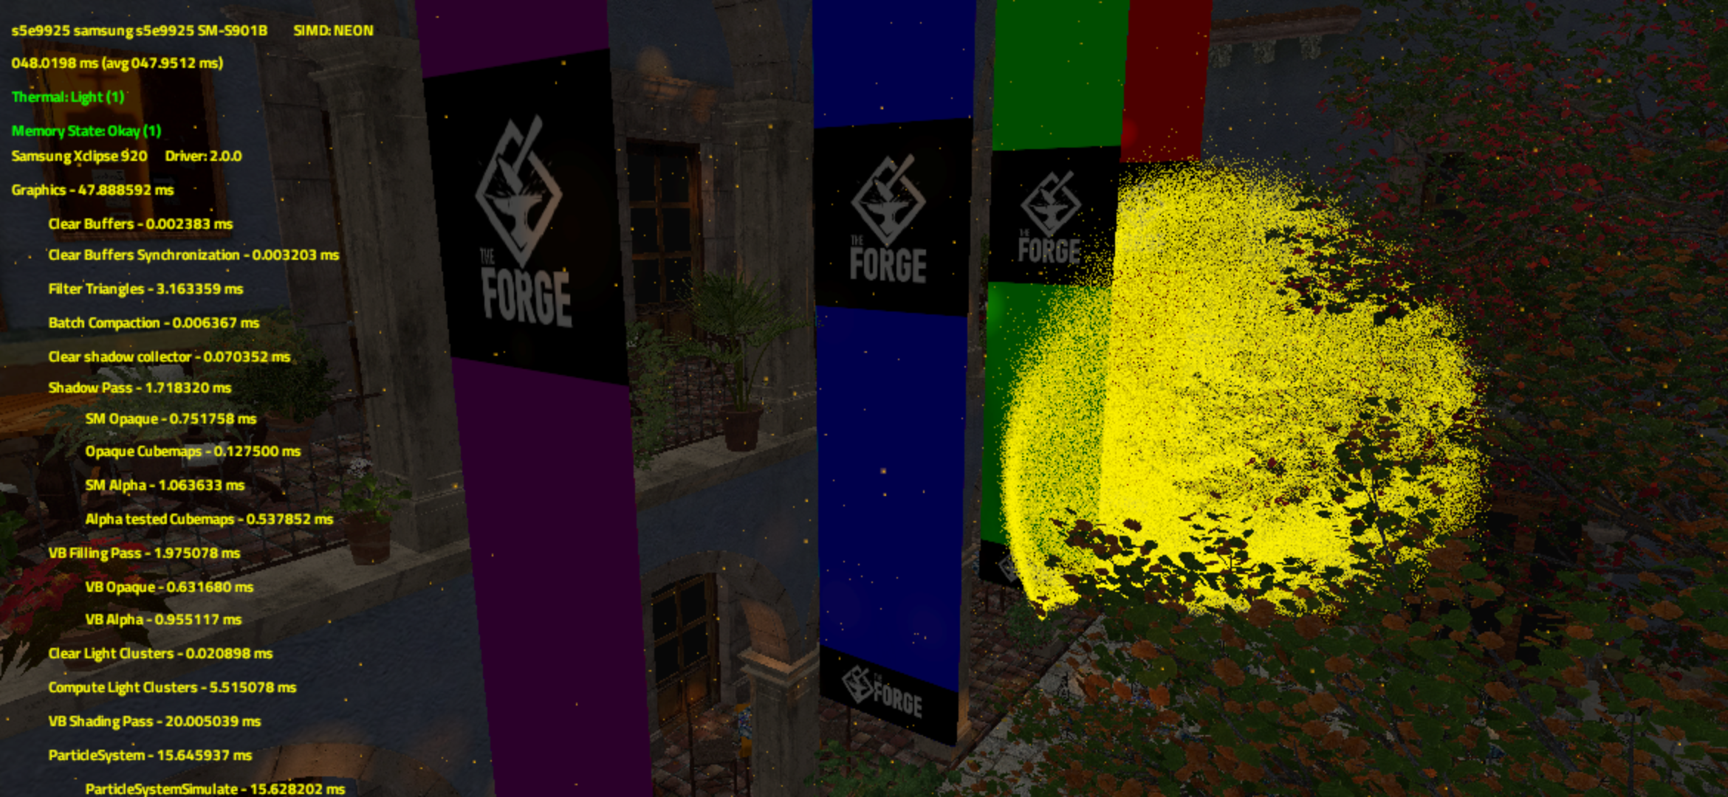
Results

Slide 13
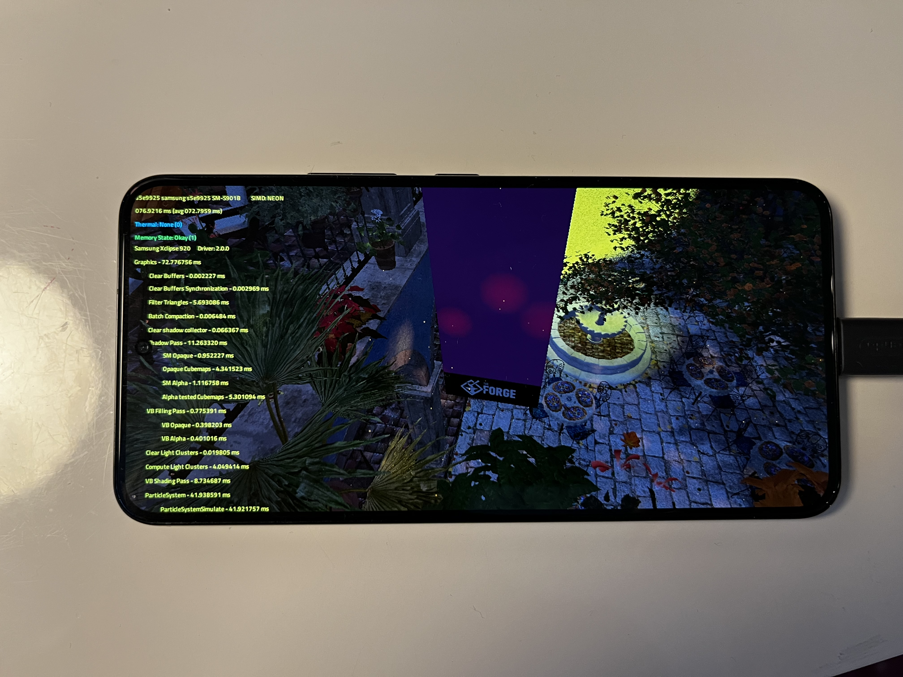
Results

Slide 14
Implementation
The whole implementation follows the idea of GPU driven rendering
  Limited interactions between CPU and GPU -> no wait for CPU and slow memory transactions
  All data is in one large buffer for –let’s say- 16 or in this case 3 million particles
  Reading / Writing that buffer is a large cost -> ideally only read / write once
One simulation compute shader run does nearly all of it
  Culls particles that are not visible
  Tracks light and shadows and hands them to the lighting & shadow system
  Applies the simulation like flocking or AI
  Rasterizes particles when they are drawn
  -> we could add more work and it would be hidden behind memory transaction

Slide 15
Implementation – Data layout
Data layout of one particle in the particle buffer
float4 PositionAndAge (Position -> xyz, Age -> w)
float4 VelocityAndBitfield (Velocity -> xyz, Bitfield -> w)
This comes down to 256 bit/32 byte
-> aligning to 32 byte and 64 byte boundaries

Slide 16
Implementation – Data layout
// Bit mask to select the allocation bits
#define PARTICLE_BITFIELD_ALLOCATION_BITS_MASK 0x1FFFFU
// Contains the index of the particle set to which the particle belongs
#define PARTICLE_BITFIELD_SET_INDEX_MASK 0xFFFFU
// Set if the particle is allocated in the buffer
#define PARTICLE_BITFIELD_IS_ALLOCATED 0x10000U
// Bit mask to select the state bits
#define PARTICLE_BITFIELD_STATE_BITS_MASK 0xE0000U
// Set if the particle is alive (Age > 0)
#define PARTICLE_BITFIELD_IS_ALIVE 0x20000U
// Set if the particle is moving and its position changes depending on velocity
#define PARTICLE_BITFIELD_IS_MOVING 0x40000U
// Set if the particle is accelerating due to gravity
#define PARTICLE_BITFIELD_IS_ACCELERATING 0x80000U
// Bit mask to select the particle type. Each particle type is initialized
// differently.
#define PARTICLE_BITFIELD_TYPE_BITS_MASK 0x300000U
#define PARTICLE_BITFIELD_TYPE_RAIN 0x0U
#define PARTICLE_BITFIELD_TYPE_FIREFLIES 0x100000U
#define PARTICLE_BITFIELD_TYPE_FIREFLIES_BOIDS 0x200000U
// Set if a particle can collide with the depth buffer
#define PARTICLE_BITFIELD_COLLIDE_WITH_DEPTH_BUFFER 0x400000U
// Bit mask to select the billboard mode
#define PARTICLE_BITFIELD_BILLBOARD_MODE_BITS_MASK 0x1800000U
// Screen-aligned quad
#define PARTICLE_BITFIELD_BILLBOARD_MODE_SCREEN_ALIGNED 0x0U
// Orient the quad towards the current velocity
#define PARTICLE_BITFIELD_BILLBOARD_MODE_VELOCITY_ORIENTED 0x800000U
// Orient the quad so that it is parallel to the ground and it faces positive Y
#define PARTICLE_BITFIELD_BILLBOARD_MODE_HORIZONTAL 0x1000000U
// Bit mask to select the lighting mode
#define PARTICLE_BITFIELD_LIGHTING_MODE_BITS_MASK 0x6000000U
// Set if the particle doesn't emit light nor shadow
#define PARTICLE_BITFIELD_LIGHTING_MODE_NONE 0x0U
// Set if the particle emits light
#define PARTICLE_BITFIELD_LIGHTING_MODE_LIGHT 0x2000000U
// Set if the particle emits light and casts shadows
#define PARTICLE_BITFIELD_LIGHTING_MODE_LIGHTNSHADOW 0x4000000U
// Set if the light of the particle is culled
#define PARTICLE_BITFIELD_LIGHT_CULLED 0x8000000U

Slide 17
Implementation – Particle Culling
Cull particles
  Outside viewport or behind camera
  Far away
Compute shader uses depth buffer to perform depth testing

Slide 18
Implementation – Emitting Light & Shadows
This is integrated into the general light and shadow system of the VB renderer
-> it uses the same code path
Bottleneck in shading is memory access, reads lots of buffers
Triangle filtering == removing for cube shadow maps
  The area of influence of a point light is used as a far plane to filter triangles
  Only triangles visible in all viewports are allowed “least common denominator”

Slide 19
Implementation – Particle Sorting
Particles are sorted depending on their type, for example: LIGHTNSHADOW, LIGHT, STANDARD
Particle sets of the same type are allocated contiguously
For lighting and shadows, we only bind the LIGHT and LIGHTNSHADOW parts of the buffer

Slide 20
Implementation – Flocking / AI
For the purpose of this demo we use the Boyd flocking algorithm to mimic a Firefly swarm
We take advantage of group shared memory to store average position and average velocity of particles in the same group without having to compare them by doing O(n^2) reads
Movement is described as a sum of forces: seek (towards a target), flee (from a point), separate (from particles that are too close), align (to the average velocity), cohesion (towards the average position) and avoid (particles that are too close)
The strength of forces is packed to save space

Slide 21
Implementation – Particle Rasterization
Because many particles are just quads, we built a simpler rasterizer
-> optional can switch on and off to see performance
In this demo we simplified rasterization to only computing the box in screen space and fill it with the particle color

Slide 22
Summary
Executing all operations on the GPU without many interactions with the CPU increases performance
-> GPU Driven rendering … we know this since a long time
Reducing the number of memory reads/writes of a large dataset in a buffer can be achieved by having a compute shader that performs all tasks in one go
-> in other words the goal is to have one read / write and the cost of this one read / write will cover the cost of a lot of arithmetic instructions
-> even redundant arithmetic instructions will be cheaper than any memory interaction with a buffer like this

Slide 23
Future Development
We are still trying to settle on a sorting algorithm
We know that we can pack more data into TGSM but using VK_AMD_shader_info doesn’t show a lack of VGPR or SGPR … so no occupancy problem so far
For the 10000 lights, we have an optimization in the Visibility Buffer code in the “other” research project that we have to bring over
-> we will be aiming to increase that number substantially
For the one cube shadow map … that is too low … this is just work in progress … we showed demos with 256 cube shadow maps in 2009 … so we will be looking into that too

Slide 24
Contact
Any questions or comments drop a line to
wolf@theforge.dev

