Slide 1

Triangle Visibility Buffer 2.0
- Compute Based Rendering -
by David Erler and Wolfgang Engel
The Forge Interactive

Slide 2
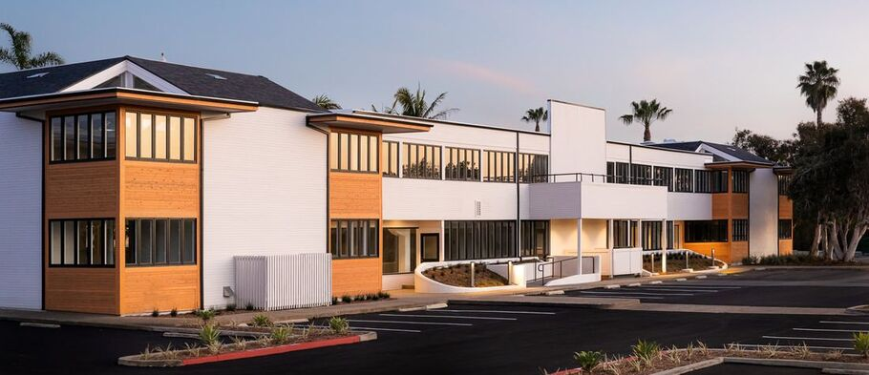
The Forge
Founded in 2009 by Wolfgang Engel
Nearly 40 graphics programmers around the world
Supports Graphics & Engine Development on vast amounts of projects
Optimizations, Feature implementation, platform ports and game engine development from Scratch
Tomb Raider, Starfield, Forza, Hades, Activision, etc…
Located in Sunny San Diego

Slide 3
The Forge
Current Projects
  Warzone Mobile
  Fable
  Qualcomm (Adreno/VR SDK)
  Meta (Population One, SDK work)
  Google (Stadia, Godot, WebGPU)
  No Man’s Sky (shipped macOS, ongoing iOS work)

Slide 4

Source Code
Open-Source cross-platform engine development framework
  https://github.com/ConfettiFX/The-Forge
  Cutting-Edge graphics Demos
  Shadows, Transparency, software VRS
Triangle Visibility Buffer based demos:
  Visibility_Buffer 1 (TVB 1.0) - IndirectDraw-based approach
  Visibility_Buffer 2 (TVB 2.0) - Source for the demo in this talk
  15a_VisilibilityBufferOIT
    TVB1
    Animation
    OIT
    Software VRS

Slide 5
Visibility Buffer History
Original idea based on an article by [Burns 13]
[Schied 15][Schied 16] implemented a modern OpenGL version using (MultiDrawIndirect) with The Forge in 2015 in our office
Incremental improvements:
  Exploit modern APIs
  Optimized memory access patterns
  Draw Compaction
  Triangle Filtering [Chajdas][Wihlidal]
  Forward++ Shading (shading with 1 draw call)
  Ported to all platforms
Great performance gains at resolutions above 1080p
  About 2X speedup on St. Miguel vs G-Buffer based renderer (Xbox One)
  Demoed on stage during XFest 2018 [Engel 16]
Memory bandwidth is the most limiting factor for our main target group
  only having two buffers (Visibility Buffer + depth buffer) improves performance substantially compared to any G-Buffer based approach
Notes:
You can say: “Everything runs well on a NVIDIA 3080 but not on the hardware our target group has”

Slide 6
Visibility Buffer History
The concept of culling triangles before the graphics pipeline and keeping track of triangles in a Visibility Buffer is now widely used in various flavors in most of the AAA game engines like Call of Duty, Unreal Engine, Square Enix game engine, Hypixel Game Engine. We are implementing it in many of the projects we are working on
TVB 1.0 exemplifies first generation GPU-based rendering
TVB 2.0 goes a large step further …
On top of that, TVB based rendering opens many new opportunities not possible with traditional methods
This talk presents one of our many research efforts exploring these possibilities

Slide 7
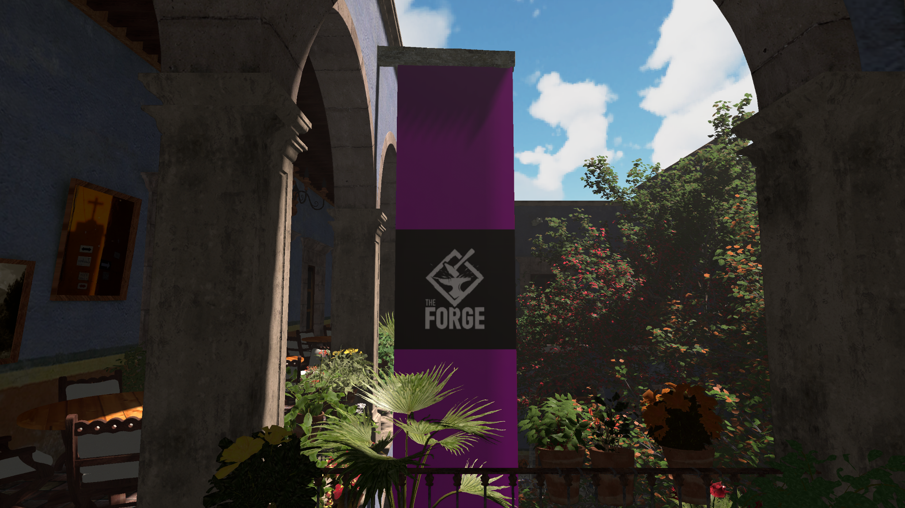
Compute-Based Rendering
Notes:
Result, runs at 7ms on RX 7600
Around 3 Million triangles

Slide 8
Main Concepts
Goal: Fully replace the IndirectDraw filling pass by compute
Unified Vertex Buffer
  Single Buffer containing all data
  Reserved Range for dynamic updates via aliasing
Geometry Sets
  Opaque
  Alpha-tested
  Transparency (AOIT)
Materials
  Single index of diffuse, normal and specular textures
  Two-Sided
Visibility Buffer
  Unified Buffer containing per-pixel Visibility Information
Bin Buffer
  Contains Bin Counters followed by triangle Indices

Slide 9
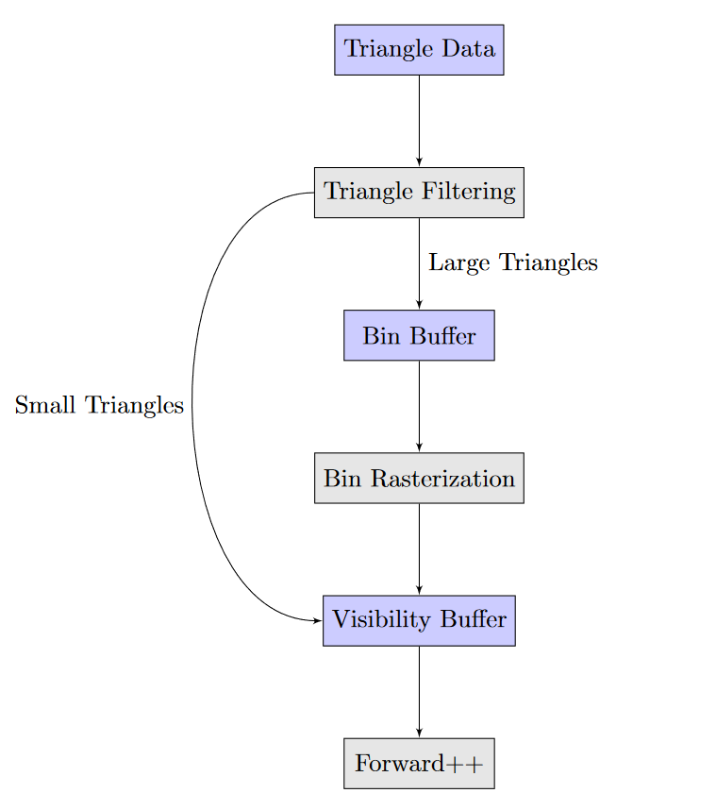
Data and Pipeline Flow
Notes:
Quiz0: Why is VB faster than deferred in General?

Slide 10
Triangle Processing & Rasterization
We use a single dispatch to process every triangle in the scene
Each thread processes a single triangle and performs culling tests (see [Chajdas] [Whilidal])
  Degenerate and Back Face
  Frustum
Multi-View Triangle Removal (see [Engel18])
  Load triangle data only once
  Process n views per thread
We determine covered pixel area per triangle and either
  Append to Bin Buffer
  Or rasterize in-place (Small Scale Rasterization)

Slide 11
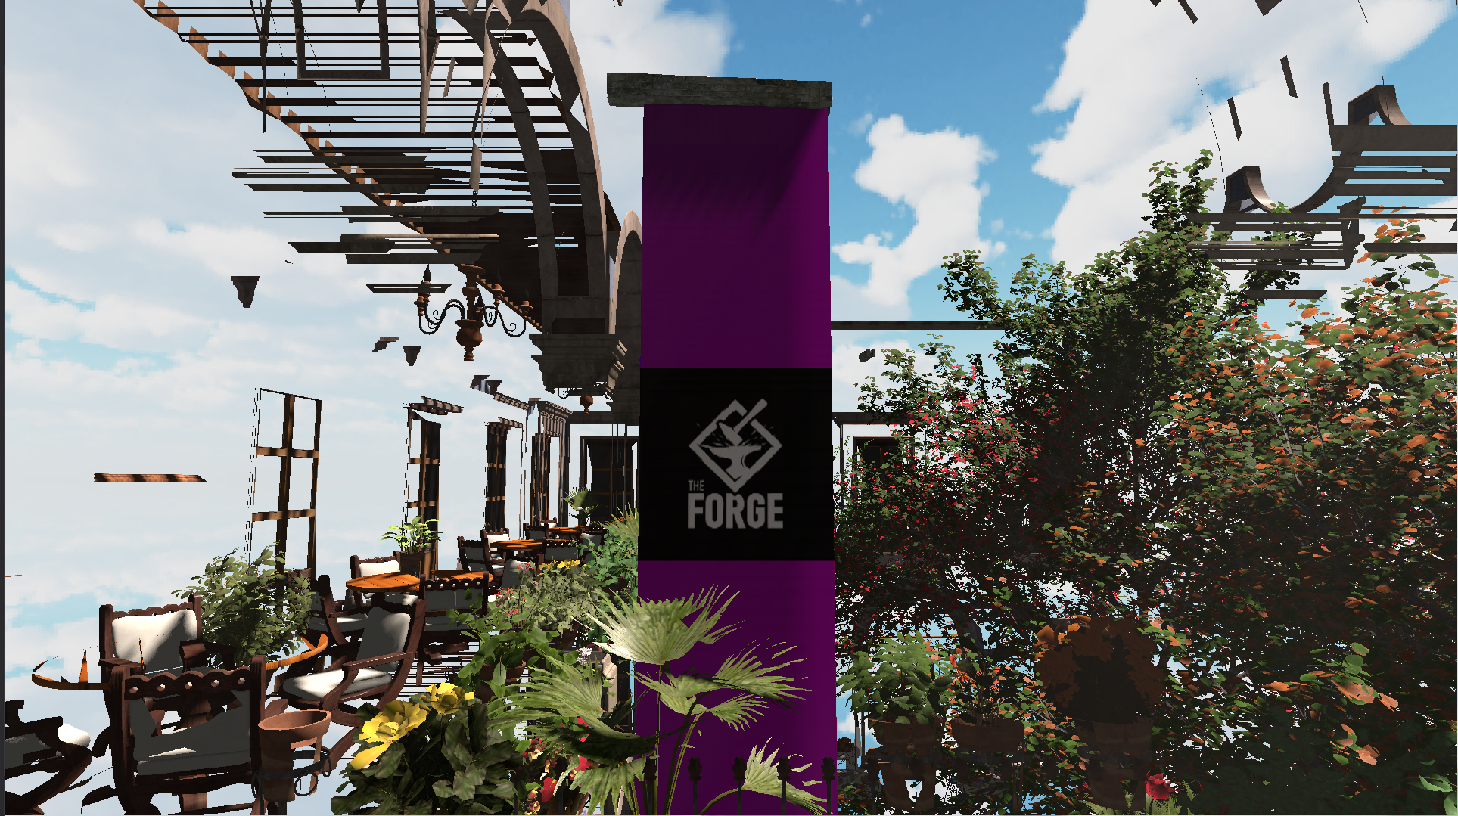
Small Scale Rasterization
Notes:
This image shows the scene when only enabling Small Scale Rasterization (only raster small triangles)

Slide 12
Small Scale Rasterization
Screenshot shows output when only performing Small Scale Rasterization
We raster triangles covering less than 32x32 pixels in-place
Triangle data: GeometrySet + MeshID + TriangleIndex
We pack depth + triangle data into 64 bit value
Loop over AABB and perform 64 bit atomics with Visibility Buffer
  Avoid reading triangle data a second time for raster altogether
  Avoid writing many small triangles to Bin Buffer
Data for larger triangles is written into the Bin Buffer

Slide 13
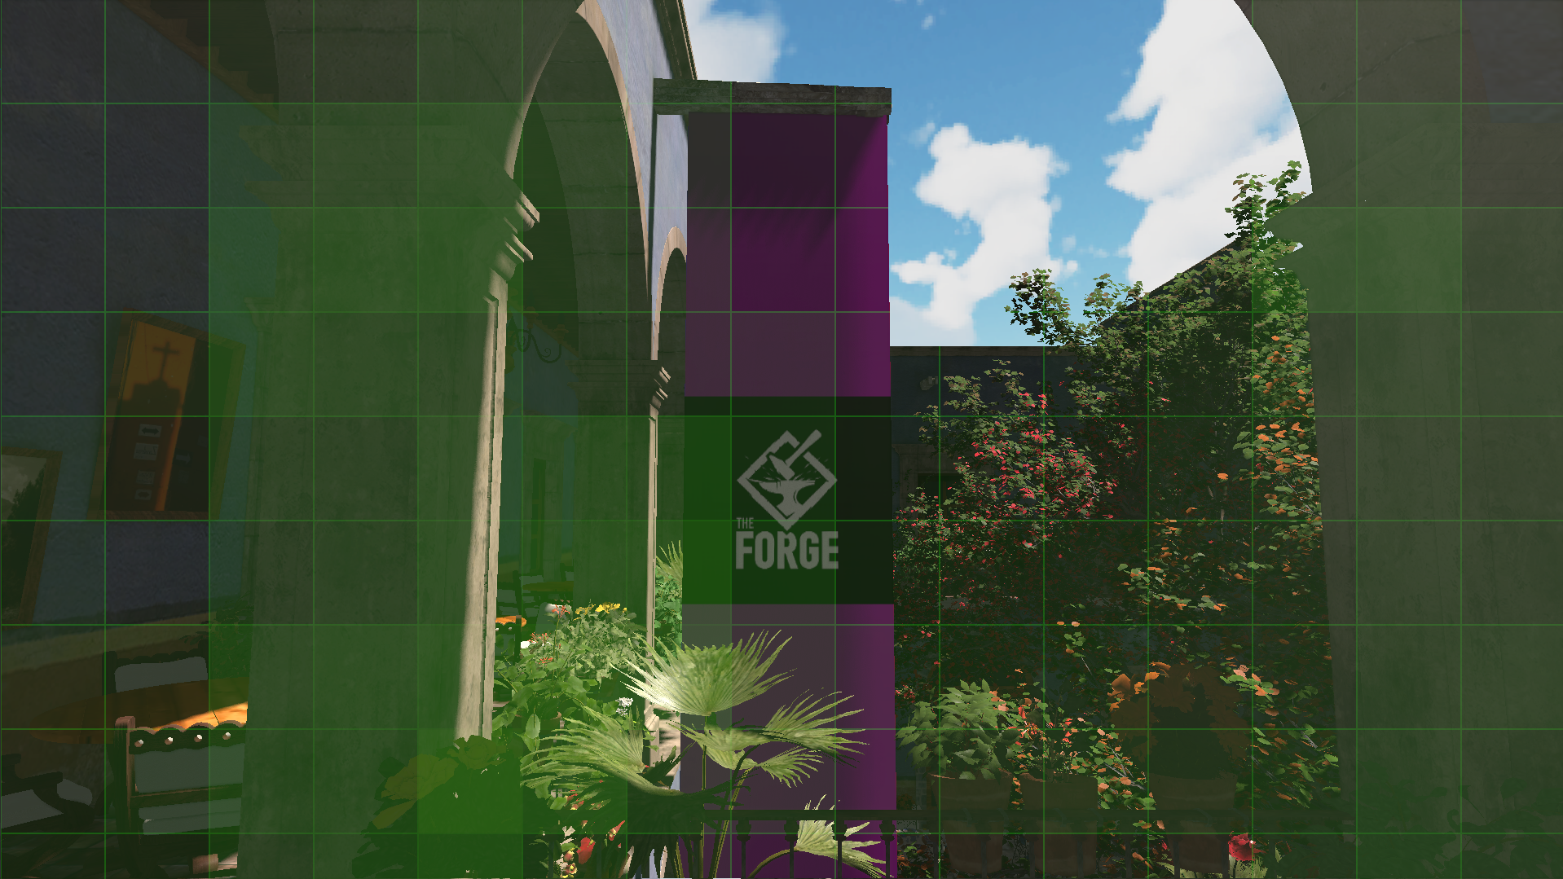
Bin Buffer

Slide 14
Bin Buffer
Screenshot shows per-bin triangle occupancy
We essentially perform very coarse rasterization over screen-aligned bins
Loop over triangle AABB
We use compacted writes back to Bin Buffer:
  Use LDS per-bin counter
  Reserve bin ranges once
Write Triangle data back without atomics
  We can avoid writing indices back to memory altogether
We found 128x128 bins to be the best performing setup @1080p
Notes:
Quiz 1: Why Unified Vertex Buffer?

Slide 15
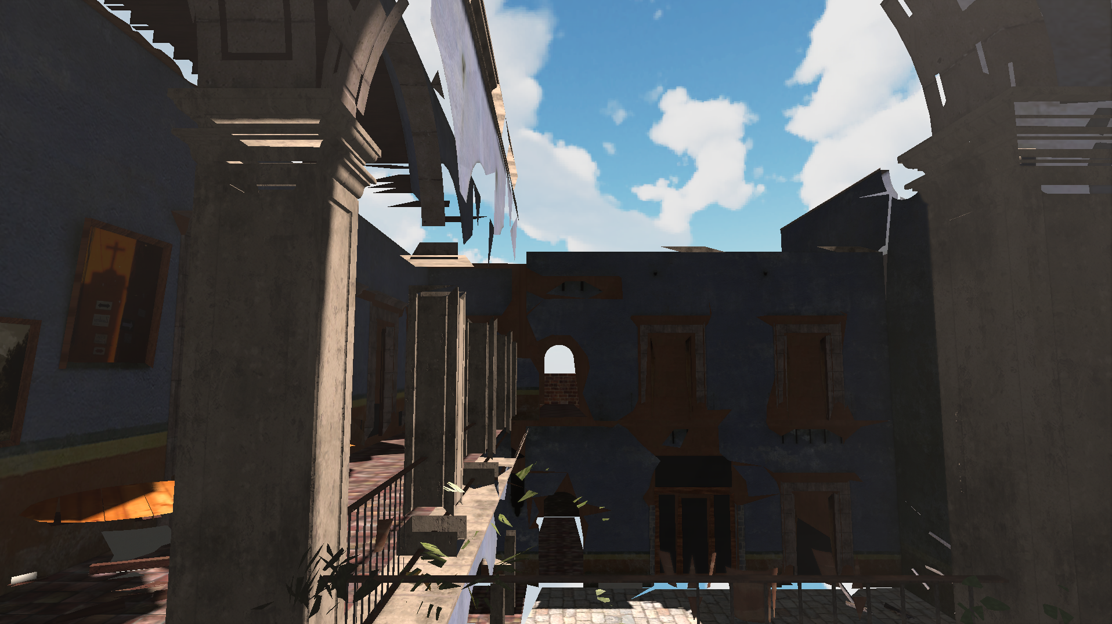
Bin Rasterization
Notes:
This image shows the scene when only enabling Bin Rasterization (only raster large triangles)

Slide 16
Bin Rasterization
Previous screenshot shows output when limiting rasterization to Bin triangles
Single Dispatch with enough groups to cover all bins
  Group size is (16,16,1), each thread:
    loads and rasterizes a single triangle (256, linearly assigned)
    writes 4x4 bin pixels (64x64 == 16x16x4x4)
  Use LDS 64x64 SubBin for rasterization (64x64x8 == 32Kb)
  Raster using Coherent Loop over fixed SubBin extents
  Pack depth + Triangle data into single uint64_t with leading depth
  Write to LDS using AtomicMax(...)
  Distribute writes to main memory over threads
We found this setup to yield the best performance @1080p
We are going to tune performance for more platforms and resolutions towards 4k

Slide 17
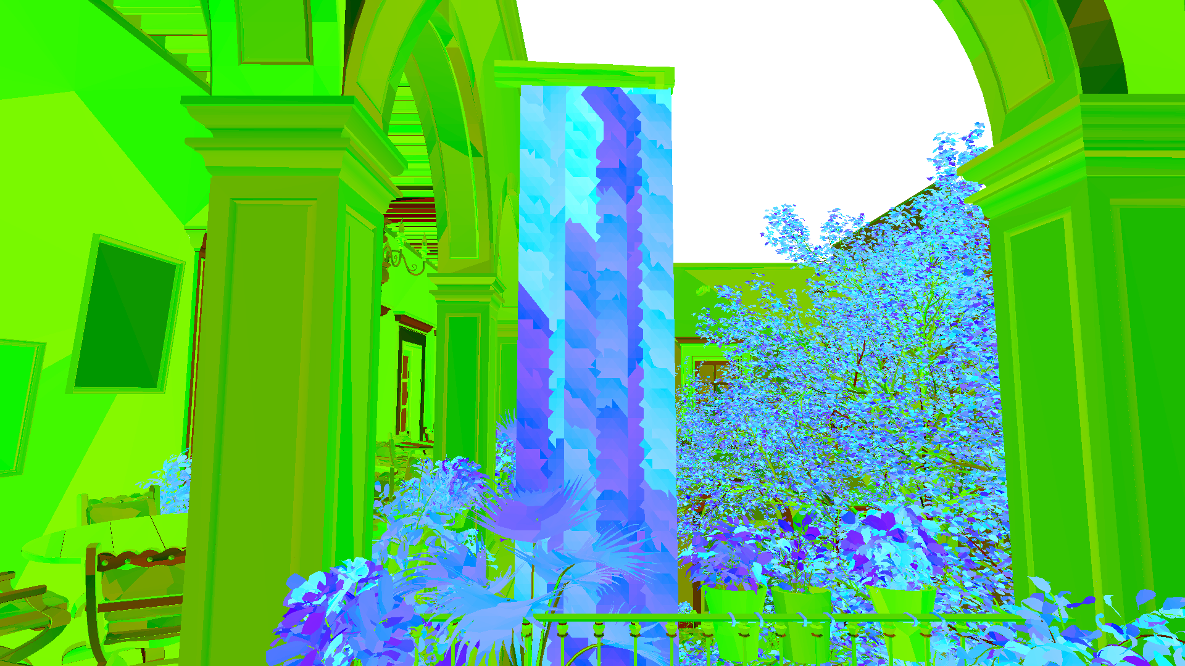
Combined Visibility Results
Notes:
Again don’t know what this image shows …

Slide 18
Blits and Shading
Outputs of previous stages are:
  Single unified Visibility Buffer
  Single unified Bin Buffer
For Shadow Mapping, Ambient Occlusion and GodRays need 4-byte depth buffers
We use Blits to extract depth and populate buffers for each view
Forward++ Shading:
  Load Visibility Buffer entry and Triangle Data
  Sample material textures
  Compute Lighting
  Apply SSAO and Ray Marching results

Slide 19
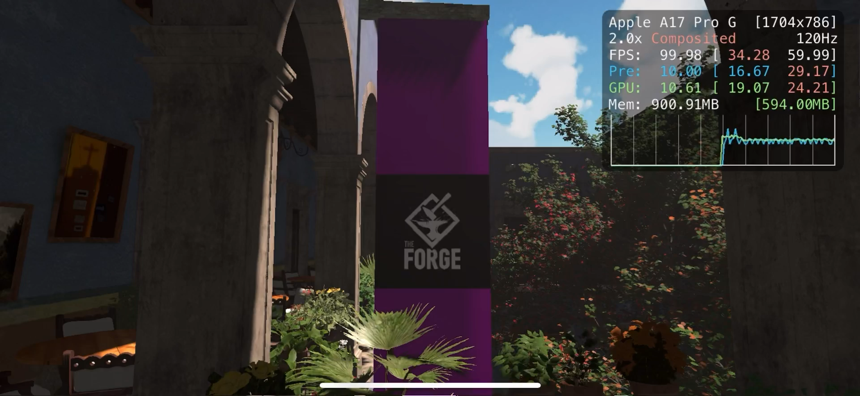
Demo

Slide 20
Performance
TVB 2.0 is currently 1.25x to 2x slower than TVB 1.0
Stage | RX 7600 (1080p) | PS5 (1080p) | PS5 (4K) | Macbook M2 (1080p) | iPhone 15 Pro (1704x786)
Triangle Processing | 3.5ms | 3.4ms | 15.5ms | 11.3ms | 19.3ms
Bin Rasterization | 1.1ms | 1.4ms | 8ms | 10.9ms | 10.2ms
Shading | 0.7ms | 1.3ms | 3.8ms | 1.8ms | 6.4ms
Total (async) | 3.8ms | 5.2ms | 15.6ms | 13.7ms | 19.3ms

Slide 21
Conclusion
TVB 2.0 offers significant simplifications over TVB 1.0
  No intermediate Batch Compaction
  No complicated and error-prone data redirection (mesh -> draw -> triangle -> VB)
Minimal cpu -> gpu interaction
  Reduced number of Draws and Dispatches
  Single Fence between Triangle Processing and Bin Rasterization
  Allows for per-view rasterization overlap
  Using Async compute, allows for Small Scale and Bin Rasterization overlap
Reduced resources to 2 Unified buffers
  Bin Buffer
  Visibility Buffer
Performance close to TVB1:
  No early z tests yet
  Different geometry sets are processed together
  ALU/memory balancing variants left to test

Slide 22
Next Steps
Work Graphs
  Improve hardware utilization
  Mesh Nodes
Ray Tracing
  Extend OIT approach
Upsampling - another research project at The Forge develops an upsampler at this moment
  Hybrid resolution rendering
  Keep VB at full res, shade at half res
  Upscale using triangle IDs
TAA
  No need for heuristics to determine sample identity
Etc.
  Lens effects
  MSAA

Slide 23
References
[Burns 13] Warren A. Hunt Christopher A. Burns. “The Visibility Buffer: A Cache-Friendly Approach to Deferred Shading.” Journal of Computer Graphics Techniques (JCGT) 2:2 1 (2013), 55– 69. Available online (http://jcgt.org/published/0002/02/04)
[Schied 15] Carsten Dachsbacher Christoph Schied. “Deferred Attribute Interpolation for Memory-Efficient Deferred Shading.”, 2015. Kit Publication Website
[Schied 16] Christoph Schied, Carsten Dachsbacher, “Deferred Attribute Interpolation Shading”, 2016, GPU Pro 7
[Chajdas] Matthaeus Chajdas, GeometryFX, 2016, AMD Developer Website http://gpuopen.com/gaming-product/geometryfx/
[Wihlidal] Graham Wihlidal, “Optimizing the Graphics Pipeline with Compute”, 2017, GPU Zen 1, Pages 277--320
[Engel 16] Wolfgang Engel, “4K Rendering Breakthrough: The Filtered and Culled Visibility Buffer”, 2016, GDC Vault: https://www.gdcvault.com/play/1023792/4K-Rendering-Breakthrough-The-Filtered
[Engel 18] Wolfgang Engel, “Triangle Visibility Buffer”, 2018, Wolfgang Engel's Diary of a Graphics Programmer Blog http://diaryofagraphicsprogrammer.blogspot.com/2018/03/triangle-visibility-buffer.html
[The Forge] The Forge Interactive, “Triangle Visibility Buffer”, 2024 https://github.com/ConfettiFX/The-Forge

Slide 24
Questions?

Slide 25
We are hiring!
wolf@theforge.dev

